Slide 1

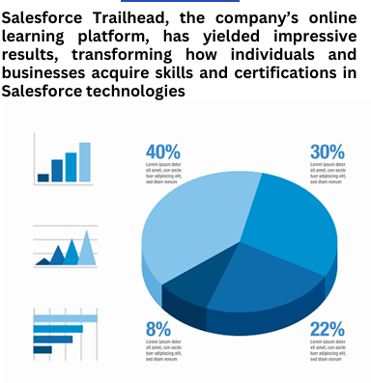
Salesforce Developer Virtual Internship
Vishnu Vardhan Reddy Kandada
Sir Padampat Singhania University
Abstract/Intro/Motivation
Objectives
Results/Discussion
Salesforce is a leading cloud-based CRM platform that offers an integrated solution, providing a unified view of every customer across various departments within an organization, including Marketing, Sales, Commerce, and Service. Our Salesforce tutorial is crafted to guide both beginners and professionals through the fundamentals and advanced concepts of Salesforce. This tutorial covers all the essential topics, starting from the basics and extending to Apex development.
Salesforce objectives often focus on streamlining business operations and boosting performance across different departments. A common goal is to increase sales revenue by effectively managing customer relationships, tracking leads, and closing deals using the platform's CRM tools. Additionally, businesses aim to enhance customer service by leveraging Salesforce's [insert feature, e.g., case management, knowledge base, community].
Methods
Salesforce employs diverse methods and strategies to drive its success and maintain its leadership in the cloud software industry. One key factor is its comprehensive suite of cloud-based tools, enabling businesses to access their data and applications from anywhere. Additionally, Salesforce fosters innovation and growth by encouraging third-party developers to build and sell applications through its marketplace, AppExchange.
Background
Salesforce, founded in 1999 by Marc Benioff, Parker Harris, Dave Moellenhoff, and Frank Dominguez, is a pioneering cloud-based software company renowned for its innovative SaaS (Software-as-a-Service) model. Headquartered in San Francisco, Salesforce revolutionized the customer relationship management (CRM) industry by providing businesses with a cloud-based platform to effectively manage customer interactions, sales processes, and data.
Future Directions
Salesforce is a leading cloud-based software company that offers a suite of CRM tools for businesses. It helps companies manage customer relationships, sales processes, and data effectively.
Notes:
feel free to change background colors & text boxes and use sections for difference purposes!

